Slide 1
Threading in .NET 4+
Justin Jones

Slide 2
Overview
Background
Process
Simple Demo
AIM – “That’s really simple, isn’t it!”

Slide 3
Super Basics
What is threading?
Why would we do it?

Slide 4
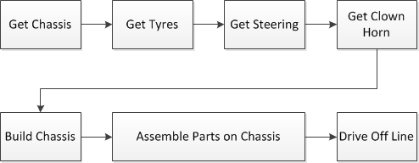
Example – Clown Car Production
Single Threaded Process

Slide 5
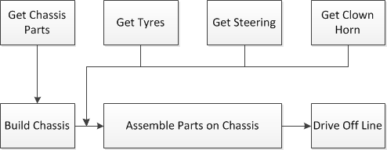
Example – Clown Car Production
Multi-Threaded Process

Slide 6
Background
.NET 1.1 -> 2 ☹
.NET 3.5 😐
.NET 4+ ☺ Almost like standard code!

Slide 7
Process For Creating A Multi-Threaded Algorithm
1. Create Algorithm with NO THREADING.
- If there is an overarching loop (e.g. through all customers) – don’t even loop it. Just do for one customer.
2. Time it and optimise it. (e.g. avoid looping on datetimes, reduce trips to db, optimise LINQ etc)
3. Once optimised, get a standard results set from it.

Slide 8
Process For Creating A Multi-Threaded Algorithm (2)
4. Call the process using several threads. Time it and ensure the data is correct.
5. Create the final threaded procedure. Test the data again.

Slide 9
Key Points for Methods
Keep properties local where possible.
Where items are passed into loops, assign to local variables within the loops.
for (int i = 0; i < 50; i++)
{
var locali = i;
…….
}

Slide 10
Key Points for Methods (2)
When threaded, methods will throw aggregate exceptions, which are a list of all the exceptions the process has thrown. Inner exception has the detail.
A standard try catch will suffice.

Slide 11
Task<T>
Using Task<T>, where T is the return type
Can make a task call a method on another thread.
DONT use inline lambda methods!
Call using Task<T>.Factory.StartNew(() => new Class().MyMethod())
Can use Task<T>.Run(), but less flexible.
Consider moving processes over 50ms out of Thread Pool (TaskCreationOptions.LongRunning).

Slide 12
Progress + Cancellation
Change a standard method to take in a ‘System.Iprogress’ parameter to show progress. Pass in a System.Progress with event pre-assigned.
Use CancellationTokenSource to be able to cancel a Threaded Process. http://msdn.microsoft.com/en-us/library/dd997396.aspx

Slide 13
Additional Info
Need to test to find optimal amount of threading
Cost of creating thread vs time gain.
32-bit – 1023 threads
64-bit – 32768 threads (and each thread runs quicker)

Slide 14
Code E.g. – Clown Car Production
Single Threaded Process

Slide 15
New Code – Clown Car Production
Multi-Threaded Process (much quicker)

